Slide 1
Pedestrian Safety Enforcement Actions
Oregon Impact Training
Yvonne McNeil, Oregon Impact

Slide 2
Introduction
PSE Grant Funds have made a difference in Oregon
184 additional OT shifts in 2020
116 citations
258 warnings
406 other citations and 460 other warnings

Slide 3
Purpose of PSE
Education, Education, Education
Increase understanding of Oregon crosswalk laws
Communicate to the public that pedestrians have the right of way at all intersections
Remind drivers to stop and stay stopped for pedestrians lane +1 (lane +6’ when turning at a traffic controlled intersection)
Stop traffic violations
Citations and warnings

Slide 4
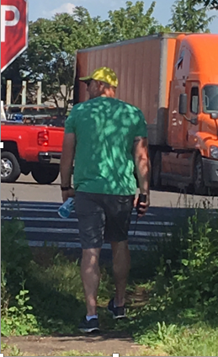
Selecting the Walker
Position within the community
Staff member (City, Police, etc.)
Volunteer
Personality
Cautious and focused
Thoughtful in their actions
Willing to step in front of oncoming vehicles
Walk rain or shine
Attire
Visible clothing

Slide 5
Training the Walker
On-site training tips:
Focus only on walking and your safety
Minimize distractions (no talking, no gestures)
Be visible
Allow drivers adequate time & distance to stop (OR law)
Approach the intersection as a walker

Slide 6
Training the Walker
Act as if you want to cross, accentuate your movements
Make eye contact with drivers
Never take your eyes off oncoming cars
“Have an out”
Be aware of the secondary threat
Walk past the intersection, pause, cross back
Keep traffic flowing as best you can

Slide 7
Site Selection Considerations
Keep a log of possible sites for next year
Community members
City Traffic Engineers
Your department
Consider locations that are priorities
Pedestrian fatalities
Transportation priorities
Locations with significant pedestrian generators
Bus/transit stops
Retail outlets
Restaurants, coffee shops
Community centers, parks, libraries
Schools

Slide 8
Site Selection Considerations
Crosswalks
Conduct a site visit to review the location
Ensure a clear view of the crossing & places to pull drivers over
Identify construction that may interfere with the flow of traffic or the enforcement action
Look for signs, signals, pavement markings, etc. that need to be corrected
Examine illumination & overhead lights for visibility (vegetation)

Slide 9
Outreach to the Media
Distribute the press announcement
1 week before the event
TV or radio
Blogs or newsfeeds
Social Media or department website

Slide 10
Outreach to the Community
Notify Businesses in the Target Area
1-2 days before the event, visit businesses, schools, organizations within 2-3 blocks of the PSE site
Notify them of the enforcement action
Encourage them to always stop for pedestrians at marked and unmarked crossings
Leave copies of the ODOT brochure “What you need to know about Oregon Crosswalk Laws”.

Slide 11
Managing the Media
Talking with the Press
Thank everyone that shows up
Get their business card for follow-up
Take a moment to answer their questions
Explain what you are doing
Describe why this location
Share how PSAs work
Provide information about OR crosswalk laws

Slide 12
Conducting the PSE
Set-Up
15-30 min before the PSE, set out signs and cones.
Determine appropriate stepping out distance
Conduct the PSE
Walker crosses back and forth in the crossing for the duration of the PSE
Contingency
Have a back-up plan if your crew needs to leave for an emergency call or one of your officers is busy with a DUII, etc.

Slide 13
Post Event Activities
Gather the Results
Number of citations
Breakdown of violations
Number of warnings
Disseminate the Results
Email to members of the media (post media)
Email to others as requested
Post on a website
Complete the required grant paperwork

Slide 14
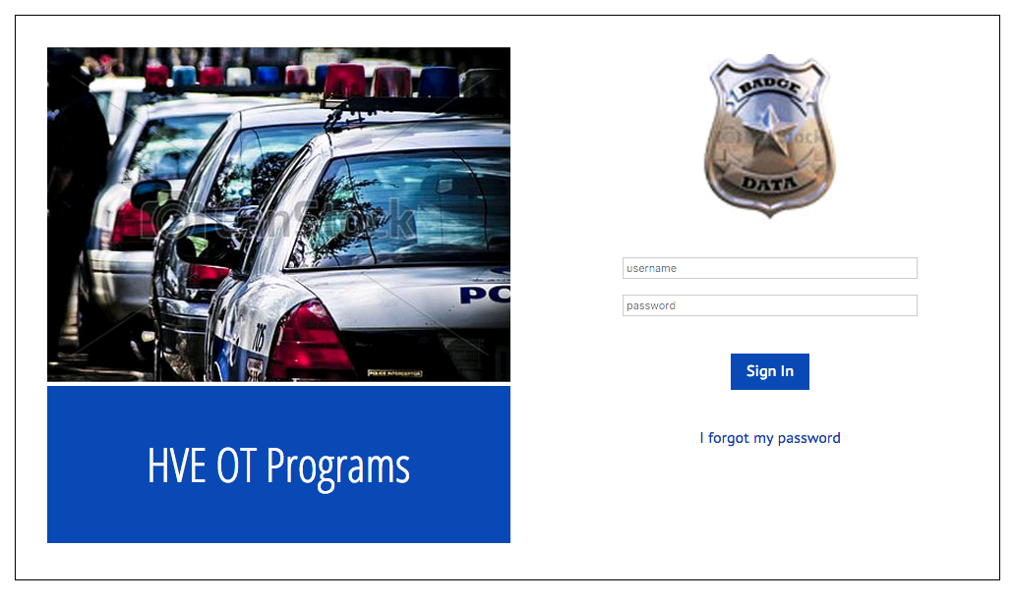
Badge Data

